Slide 1
Plant Disease Detection using Convolutional Neural Network
Presented By:
Md Fariyaz Rahaman – CSE224030
Imatj Ali – CSE224033
Under the Guidance :
Dr. Zeenat Rehena
Department Of Computer Science & Engineering
Aliah University

Slide 2
Contents
Introduction
Challenges
Objectives
Literature Survey
Model Description
Packages and Platforms used
Dataset Description
Flowchart
Work Process
Result & Discussion
Conclusion
References

Slide 3
Introduction
Plant diseases considerably reduce crops yield and agricultural productivity.
Traditional disease detection depends upon a person's visual examination by experts.
Previous techniques relied on image processing and machine learning methods.
Deep learning models such as CNNs attained improved accuracy for disease classification.
A plant disease detection system based on CNN is developed using leaf images.
The implementation has been done using a Streamlit web application for real-time disease prediction.

Slide 4
Challenges
Variations in lighting, background, and image quality affect model accuracy.
Some plant diseases have very similar visual symptoms, making classification difficult.
Imbalanced dataset across different disease classes can lead to biased predictions.
Real-world field images may differ from dataset images, reducing model generalization.

Slide 5
Objective
To design and develop an intelligent CNN-based deep learning system that accurately detects and classifies healthy and diseased crop leaves from leaf images using a standard dataset.
To build a user-friendly web application that enables users to upload leaf images, receive disease detection results, and obtain appropriate remedial or treatment suggestions to support timely decision-making for farmers.

Slide 6
Literature Survey
Sl. No. | Author(s) | Paper Title | Method Used | Year
1 | Dubey et al. | Detection and Classification of Apple Fruit Diseases Using Local Binary Patterns | Image Processing + SVM | 2014
2 | Revathi et al. | Classification of Cotton Leaf Spot Diseases Using Image Processing Techniques | Image Processing + ANN | 2012
3 | Pujari et al. | Detection of Plant Diseases Using Image Processing Techniques | Image Processing + KNN | 2015
4 | Kamble et al. | Crop Disease Detection Using Convolutional Neural Networks | CNN | 2018
5 | Patil et al. | Plant Disease Detection Using Deep Learning Techniques | CNN | 2019

Slide 7
Model Description
Neural Networks are multi-layer models composed of interconnected artificial neurons used for tasks such as classification and prediction. Each artificial neuron is a mathematical function that takes input values, multiplies them by learnable weights, adds a bias, and passes the result through a non-linear activation function to produce an output.
Convolutional Neural Networks (CNNs) are a specialized type of neural network designed specifically for image data. Like neural networks, CNNs consist of neurons with learnable weights and biases, but they exploit the spatial structure of images. By assuming the input is an image, CNN architectures efficiently capture visual features such as edges, textures, and shapes, leading to improved image classification performance.

Slide 8


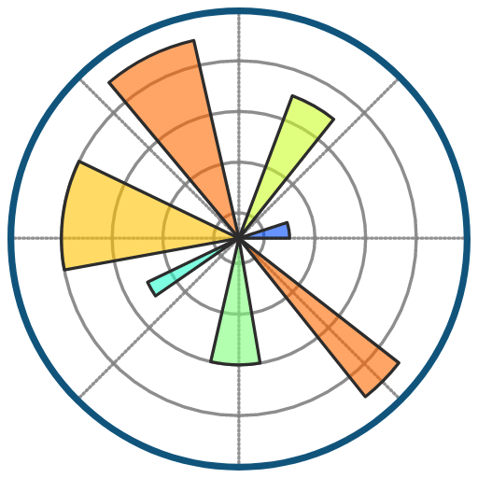



Packages
Platforms
Packages and Platforms used

Slide 9
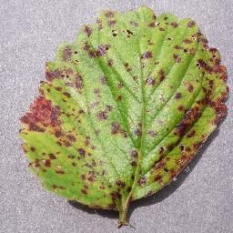
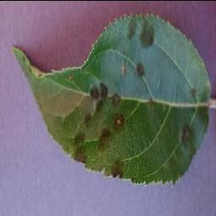
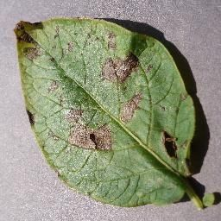
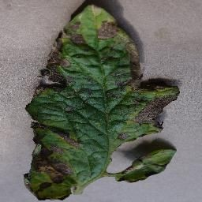
Dataset Description
Dataset :- PlantVillage Dataset
Source: https://www.kaggle.com/datasets/abdallahalidev/plantvillage-dataset
Images count: 54.00K
Type: RGB(color) Classes: 38

Slide 10
Dataset Description
The PlantVillage dataset is a publicly available collection of plant leaf images used for disease detection.
It contains over 54,000 RGB images from 14 different crop species such as apple, potato, tomato, and grape.
The dataset includes 38 disease classes, covering both healthy and diseased plant leaves.
Images are captured under controlled conditions with uniform backgrounds.
The dataset is suitable for training and evaluating deep learning models like CNNs.

Slide 11
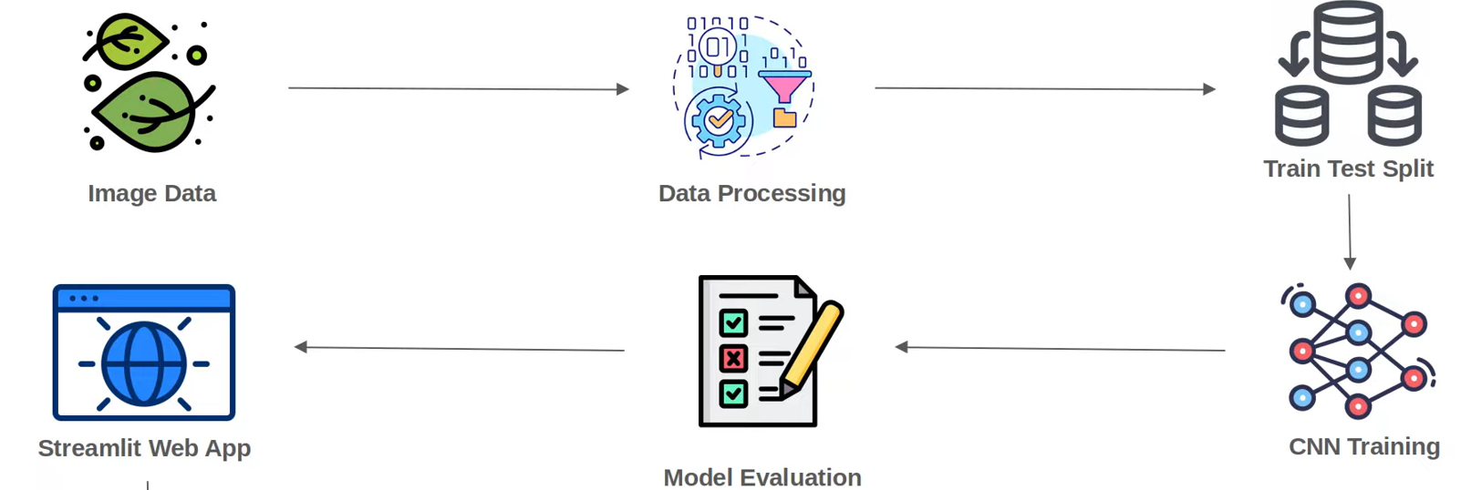
Flowchart

Slide 12
work Process
Leaf images are collected from the PlantVillage dataset containing healthy and diseased plant samples.
Dataset Collection
Images are resized, normalized, and split into training and validation datasets.
Data Preprocessing
CNN Model Training
A Convolutional Neural Network (CNN) is designed and trained to learn disease-related features from leaf images.
The trained model is evaluated using validation accuracy and loss.
Model Evaluation
Web Application Development
A Streamlit-based web application is developed to upload leaf images and display disease prediction results in real time.

Slide 13
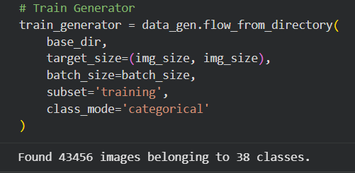
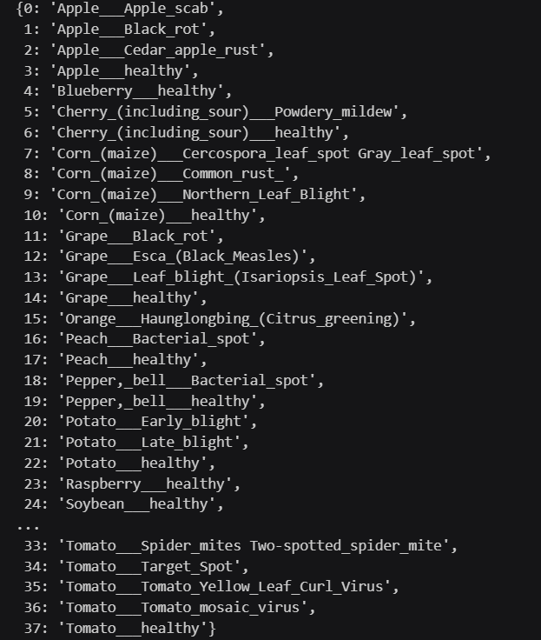
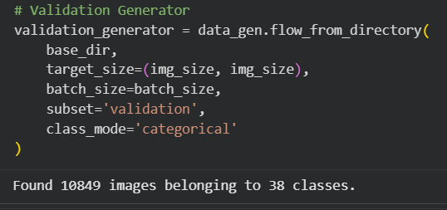
Result & Discussion
Train generator
Validation generator
Classes

Slide 14

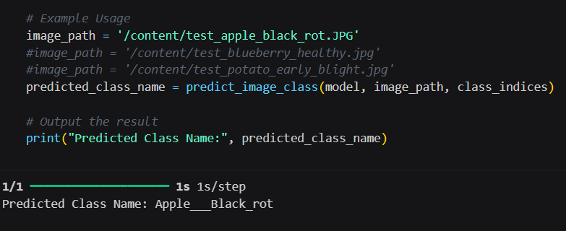
Result & Discussion(Cont.)
Model Evaluation
Output the result

Slide 15
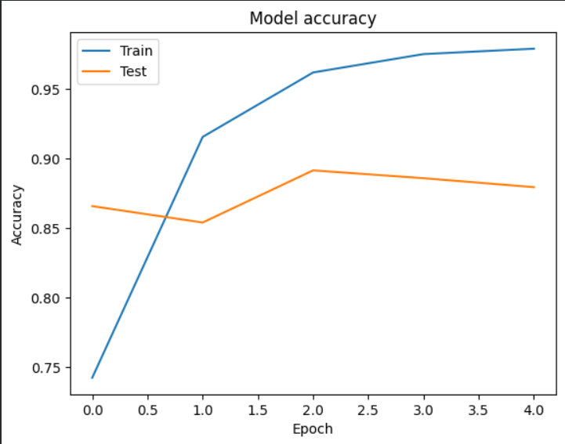
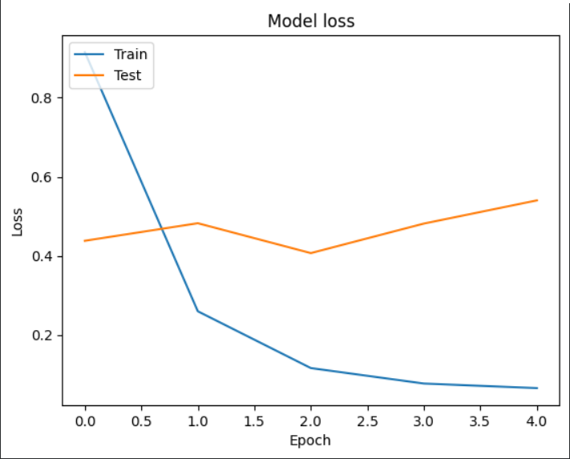
Result & Discussion(Cont.)
training & validation accuracy values
training & validation loss values

Slide 16
Result & Discussion(Cont.)
The CNN model was trained on the PlantVillage dataset containing 54,305 RGB leaf images across 38 plant disease and healthy classes.
The dataset was split into 43,456 training images and 10,849 validation images using an 80:20 ratio.
The proposed CNN architecture consists of two convolutional layers, max-pooling layers, and fully connected dense layers.
The model contains 47.8 million trainable parameters, enabling effective learning of complex leaf disease patterns.
After training for 5 epochs, the model achieved a validation accuracy of 88.36%, indicating strong classification performance.
The decreasing validation loss (0.7252) confirms good generalization and reduced overfitting.
Visual inspection of sample image pixel values confirms correct image loading and preprocessing.
The trained model successfully predicted disease classes for unseen test images, demonstrating practical usability.
Overall, the results prove that the CNN model can accurately identify plant diseases across multiple crops using leaf images.

Slide 17
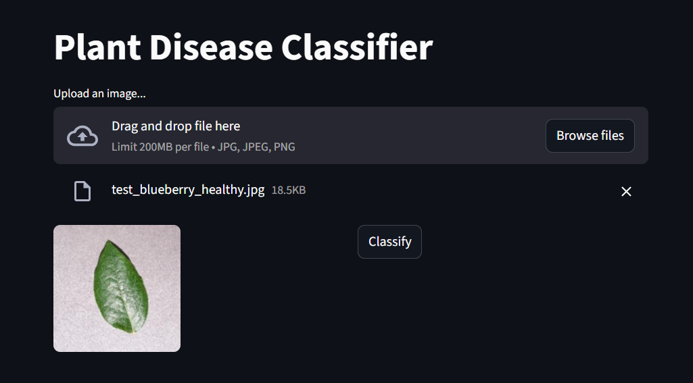
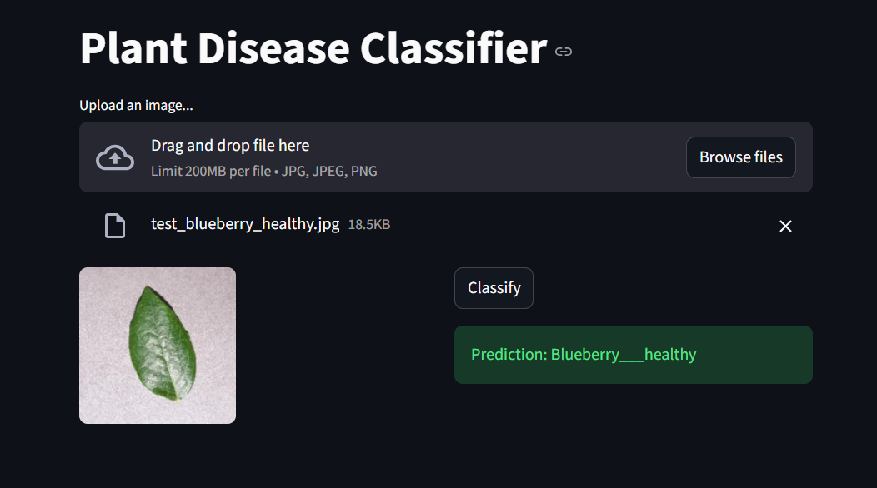
Web Interface
After choosing the image

Slide 18
Conclusion & Future Work
Conclusion
A CNN-based plant disease detection model was developed using the PlantVillage dataset.
The model accurately classifies healthy and diseased plant leaf images.
A Streamlit web application enables simple and real-time disease prediction.
The system supports early disease identification, helping reduce crop loss and improve productivity.
Future Work
Improve accuracy using advanced CNN models and transfer learning techniques.
Train the model with real-world field images for better generalization.
Deploy the system as a mobile or cloud-based application for wider access.
Expand the dataset to include more crops and disease categories.

Slide 19
References
Sharma, A. (2018). Plant disease detection using convolutional neural networks. International Journal of Computer Applications, 180(25), 15–20.
Verma, R. (2019). Deep learning approach for plant leaf disease classification. International Journal of Engineering and Advanced Technology, 8(6), 1021–1026.
Patel, P. (2020). Crop disease identification using image processing and CNN. International Journal of Innovative Technology and Exploring Engineering, 9(4), 233–238.
Kumar, S. (2021). Plant disease recognition using transfer learning techniques. International Journal of Recent Technology and Engineering, 10(2), 45–50.
Singh, N. (2022). Automated plant disease detection using deep convolutional neural networks. Journal of Artificial Intelligence and Agriculture, 6(1), 12–18.

Slide 20
Thank You

